Slide 2
intro

Slide 3
Implementation
Python
Initial temperature 10^6 -> random noise
concurrency optimization
GIL – global interpreter lock
Processes instead of threads - Multiprocessing
Lots of data transfer on windows – no time saving
Linux has copy on write -> much faster

Slide 4
Results

Slide 5
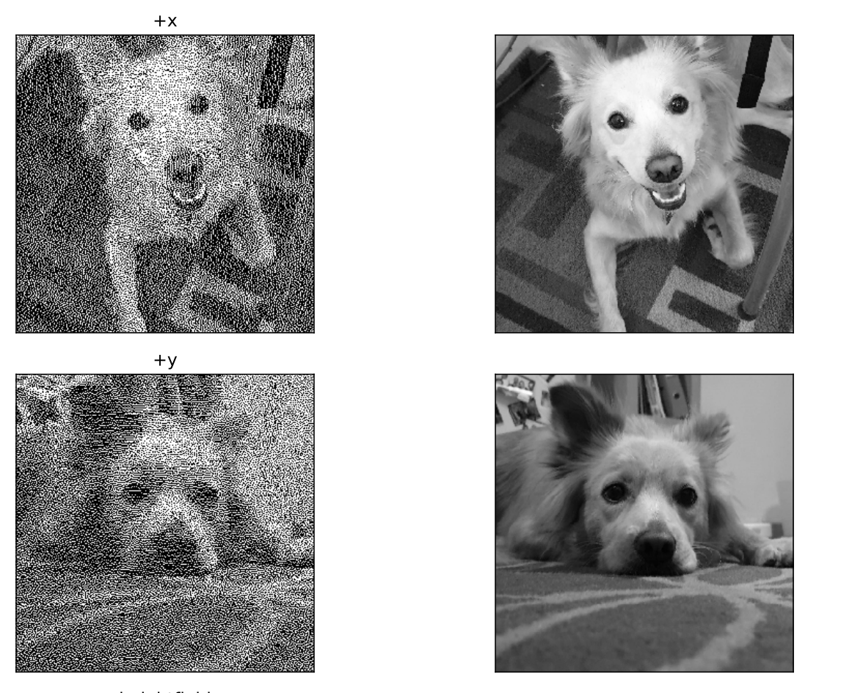
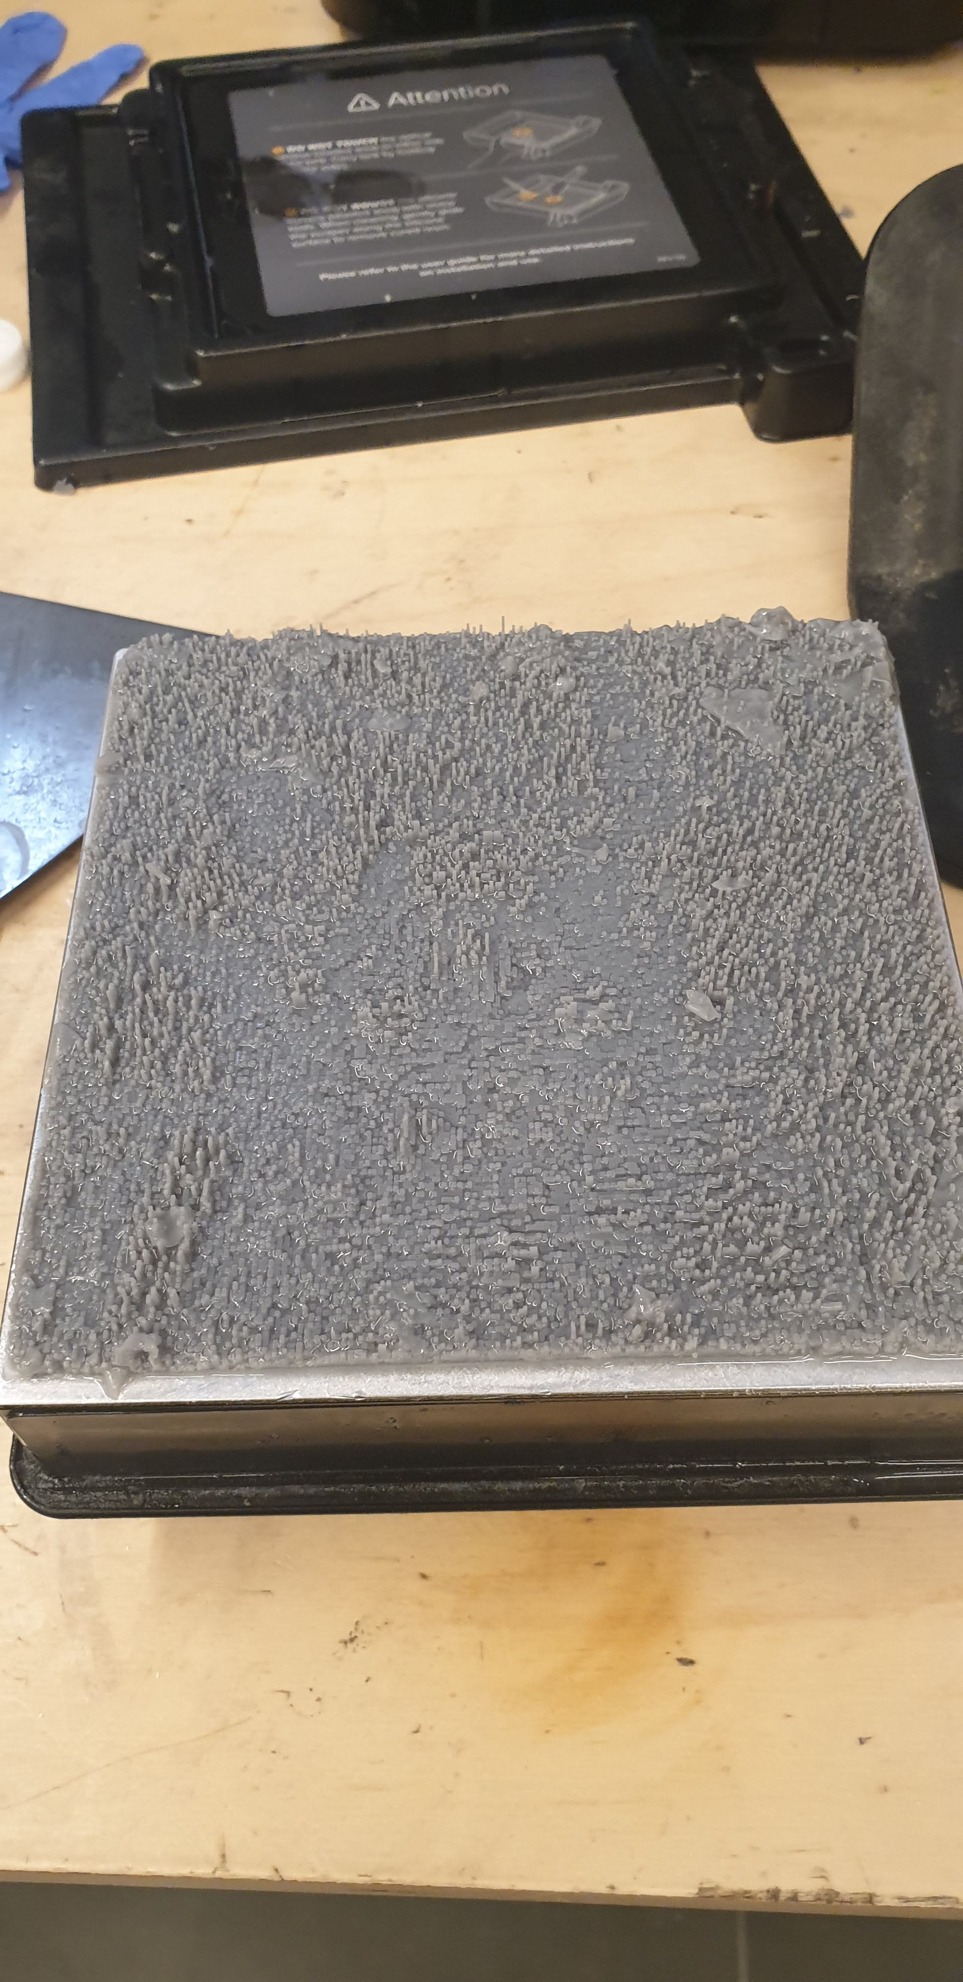
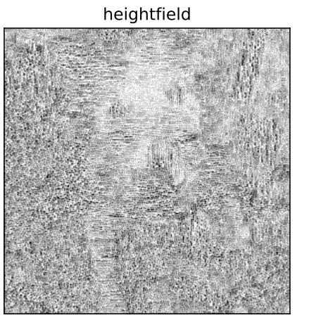

Assi

Slide 6
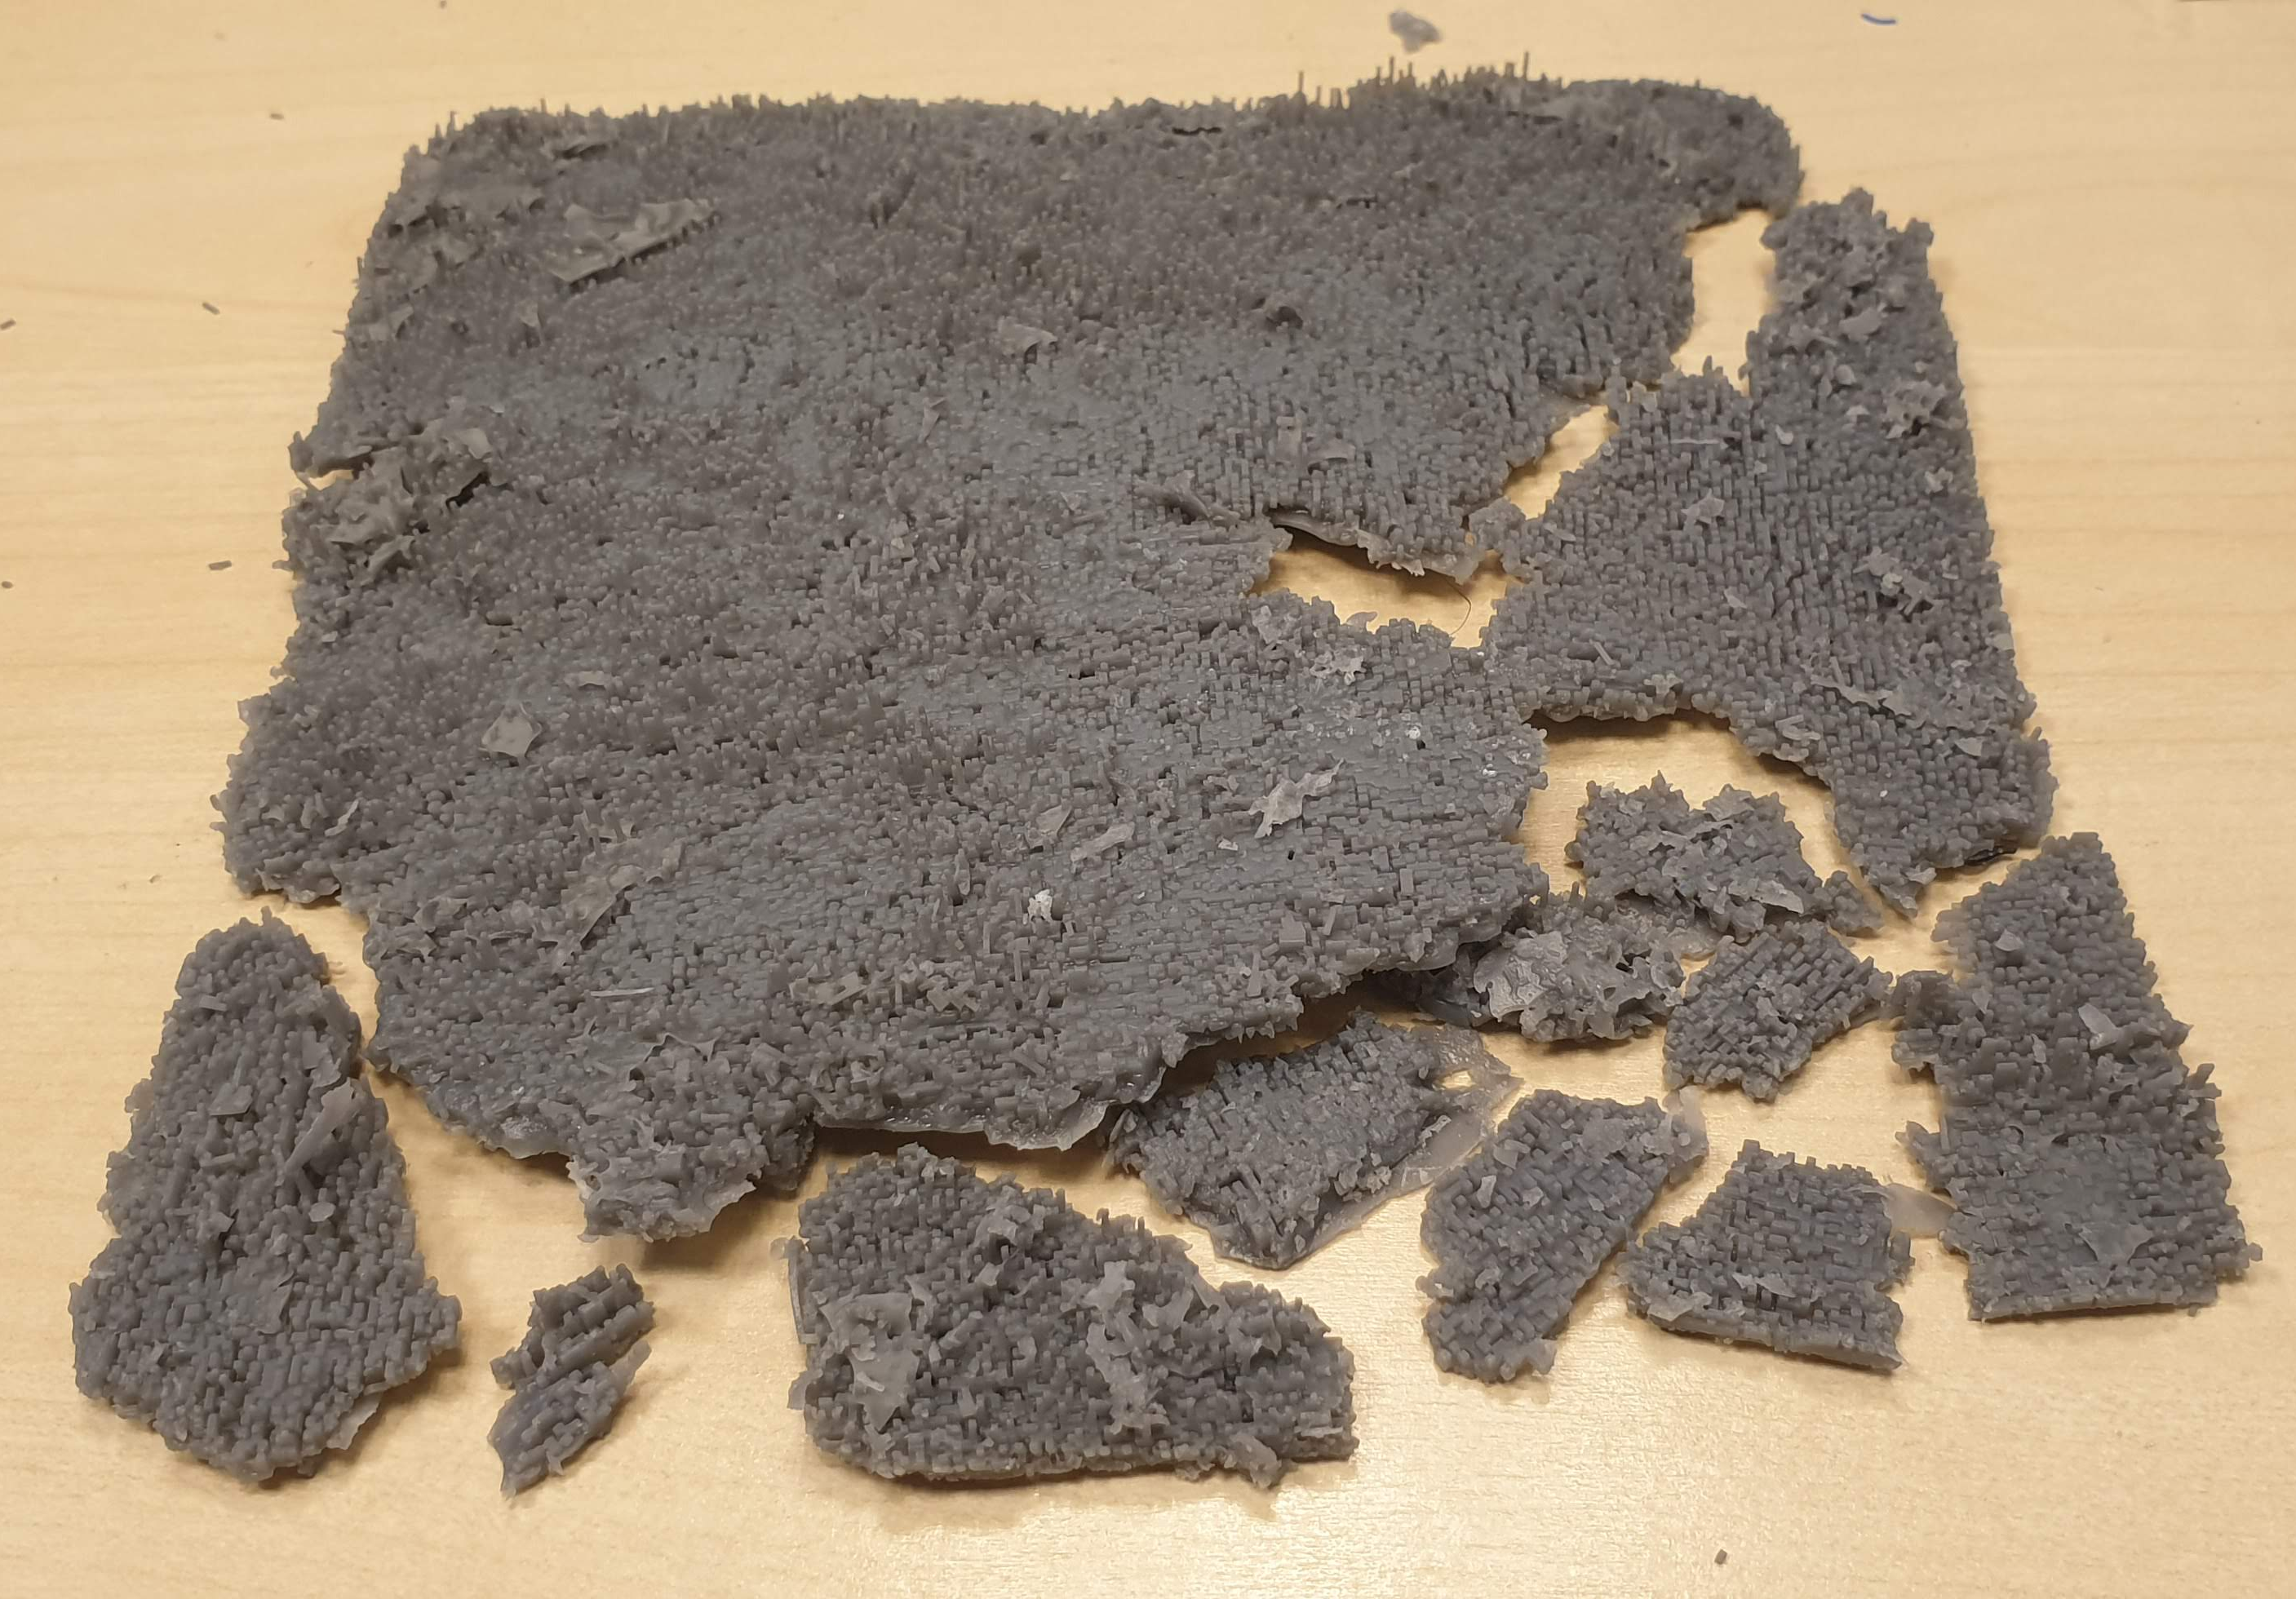
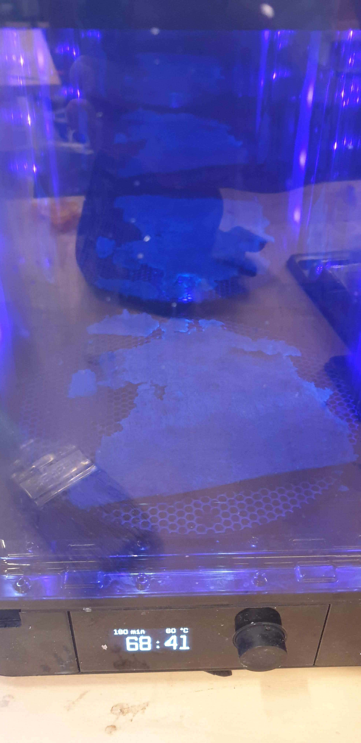

Slide 7
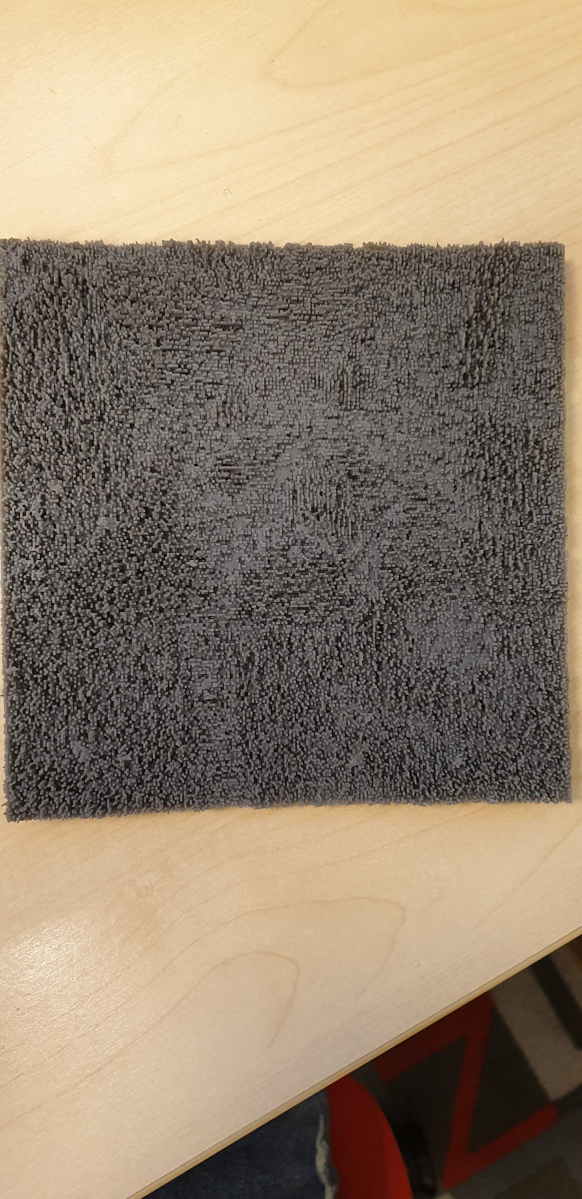
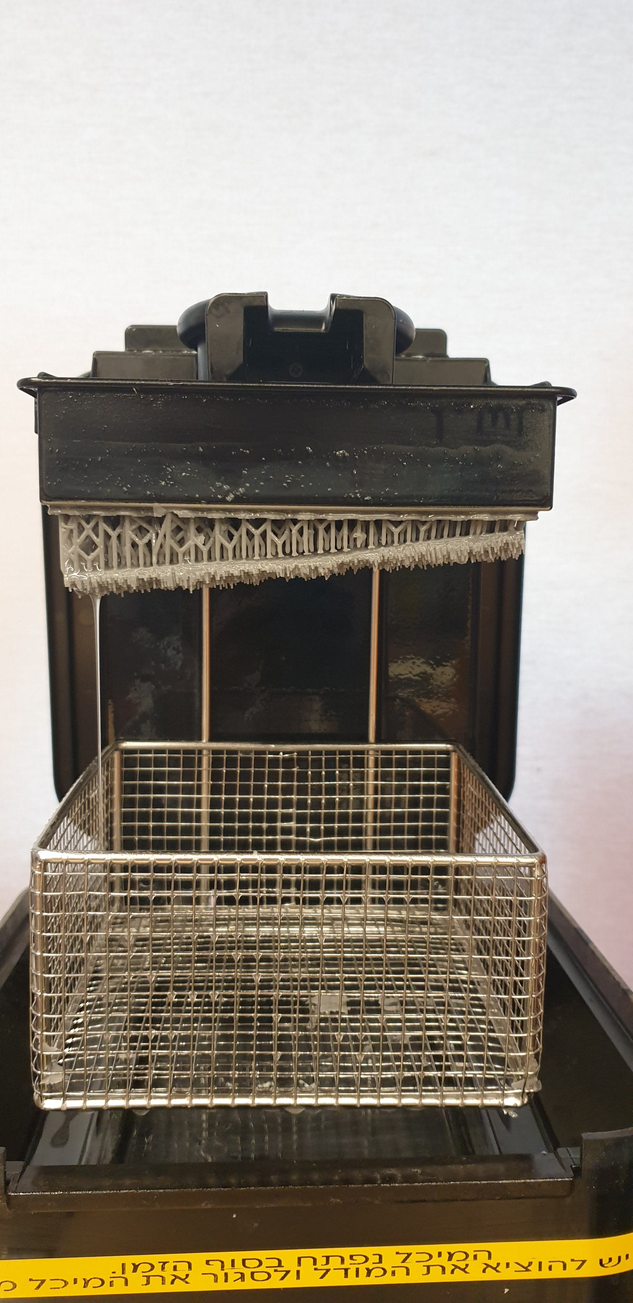
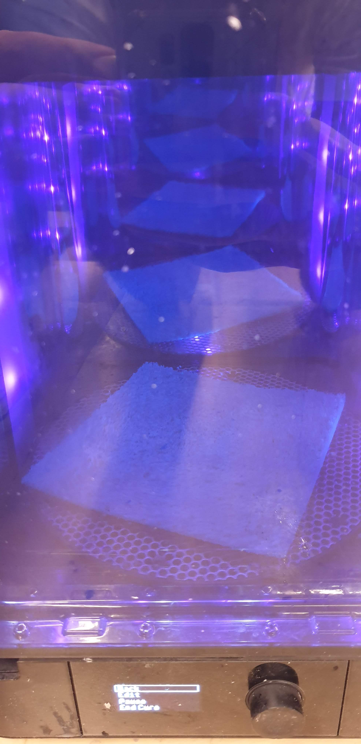

Slide 8
Results
Rick and morty

Slide 9
Results
Albums

